Slide 1

TEAM Training
Going Online
3/23/21

Slide 2
Agenda
TEAM Staff page – a new place to hold everything you need
TEAMS – making its grand opening
Where’s the T drive been lately?
Apps Online – That’s right its happening – now.

Slide 3

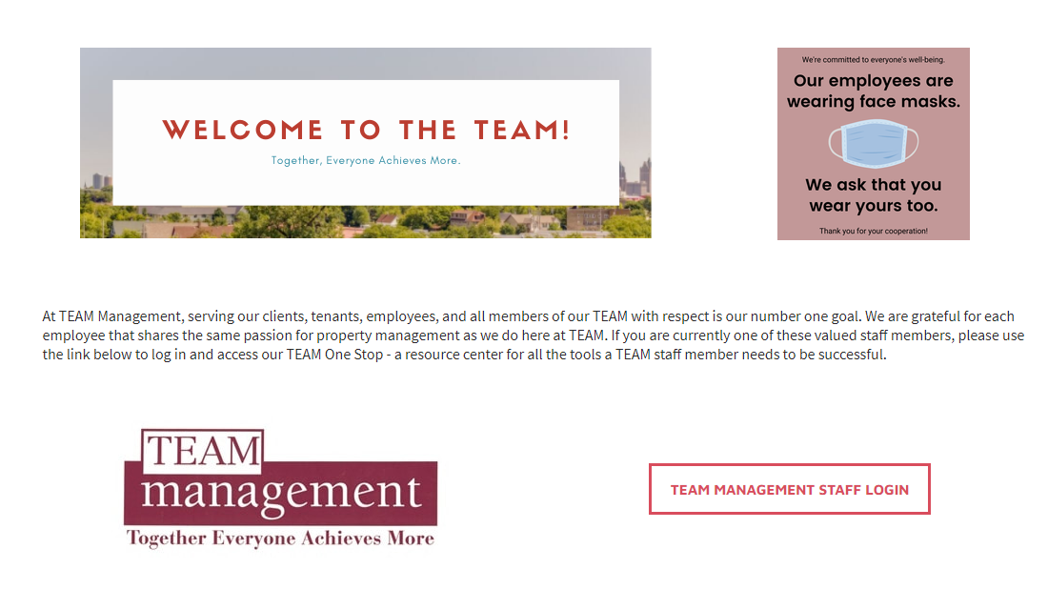
TEAM Staff PAge
Check it out!
On the TEAM Website – last tab to the right.
Log in with your account to see the pages.
Click any page and read the content.
To create an account – you will receive an email and make your own password.
  If you forget it, you can reset it right on the site!

Slide 4
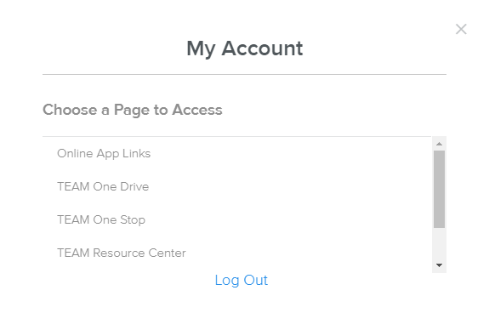
What does it have?
TEAM One Stop
  All the links you would ever need!
TEAM One Drive
  Company File Storage
Online App Links for properties
  Theres one for all of your properties!
  (Starting 3/24/21)
TEAM Resource center
  HR Resources

Slide 5
Microsoft teams
We will be using this daily for all of TEAM communication.
It is a part of your Office 365 package.
Start using it with your coworkers, supervisors, and for chats!

Slide 6


Microsoft
TEAMs

Slide 7

Where's the T-drive?
Its in the cloud!

Slide 8
The T-Drive is now One Drive!
The T-Drive will be going online too!
You can find the link on the website and also in your one drive!

Slide 9

Online applications and recertifications
All applications and recertifications can now be done in rent café!
To get a log in, you will receive an email with a link to create your password.
If you forget it, you can always reset it!

Slide 10
Rent Café summary
Residents will create their own account to complete their application.
This is how we will get maintenance requests, online rent payments, and complete recerts.
You can also send letters and emails through Rent Café.

Slide 11
ReCap
The TEAM website has a new site for staff. There are plenty of resources there.
ALL employees must begin to use TEAMS. If there is communication missed, you may be held responsible just as you would an email.
The T-Drive is making a switch to one drive. As of April 1st, everything must be stored in the One Drive.
Online applications will be ready 3/23/21. Be ready for issues. WE CAN DO THIS!

Slide 12
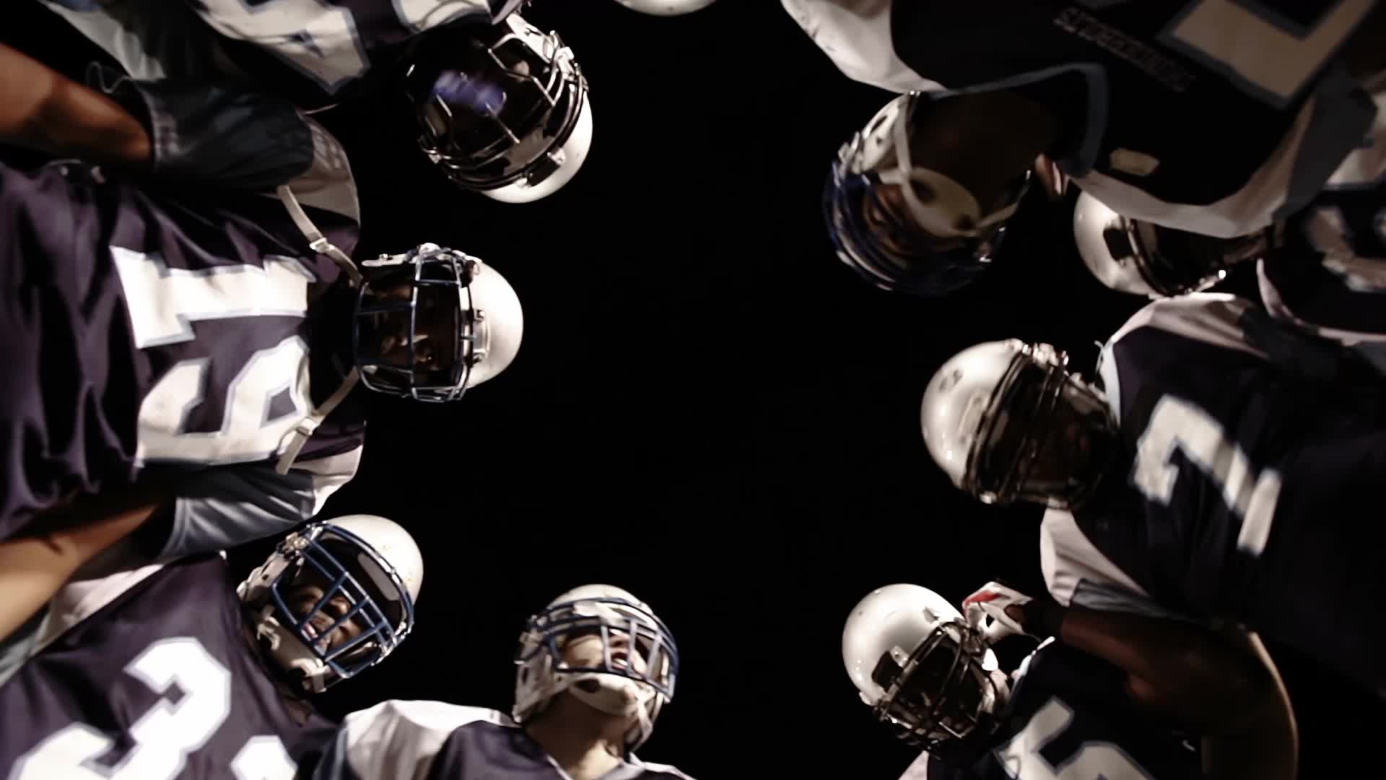
Good Job TEAM!

